Slide 1
E-Mela
A Quick-Commerce Platform
for Local Businesses
Team Members:
2310030014 - Madhusudan
2310030086 - Manav
2310030333 - Deepika
2310030445 - Vyshnavi

Slide 2
E-Mela
E-MELA is a quick-commerce platform designed to support small and independent businesses by giving them an online presence.
Eliminates high commission fees, enhances visibility, and enables instant payments.
Offers a curated, localized, consumer-driven digital mela experience.

Slide 3
Introduction
Quick-commerce platform to support the small and independent businesses in our neighborhood by providing them with a means to exhibit their products online and spread their reach to a wider and targeted customer base.
Allows the different independent businesses such as handicrafts, boutique clothing stores, custom pc building, small event planning etc to immediately tap into the opportunities provided by a unified online market.

Slide 4
Survey of Existing Platforms
Amazon Karigar: High commission, low visibility.
Udaan: Lacks B2C & personalization.
Indiamart: No logistics support or local business focus.
E-MELA improves on all these points.

Slide 5
The Challenge: Independent Businesses Online
Limited Online Presence
Competitive Disadvantage
Local businesses struggle to reach audiences beyond their physical location.
Large e-commerce platforms dominate, making it hard for small shops to compete.
High Marketing Costs
No Central Platform
Local stores face expensive ads to find targeted customers.
Neighborhood businesses lack a shared online space to showcase products.

Slide 6

E-Mela: Our Solution
Quick-Commerce Focus
Easy Online Exhibition
Targeted Local Reach
Designed specifically for small, independent businesses to sell fast.
Simple interface for businesses to display products instantly.
Connects sellers directly with local customers in their community.

Slide 7



Technology Stack
Frontend
HTML, CSS, Spring Framework
Backend
JDBC, MongoDB
Request Handling
Spring Boot

Slide 8
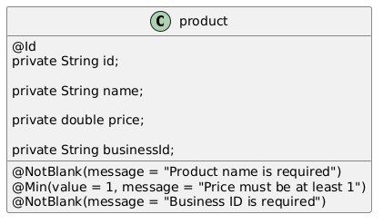
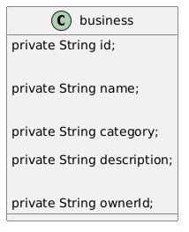
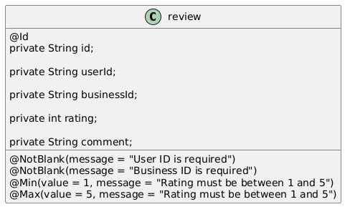
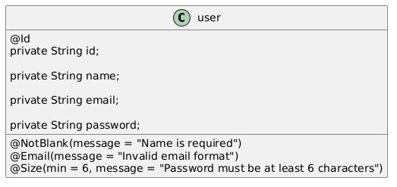
Class Diagrams

Slide 9
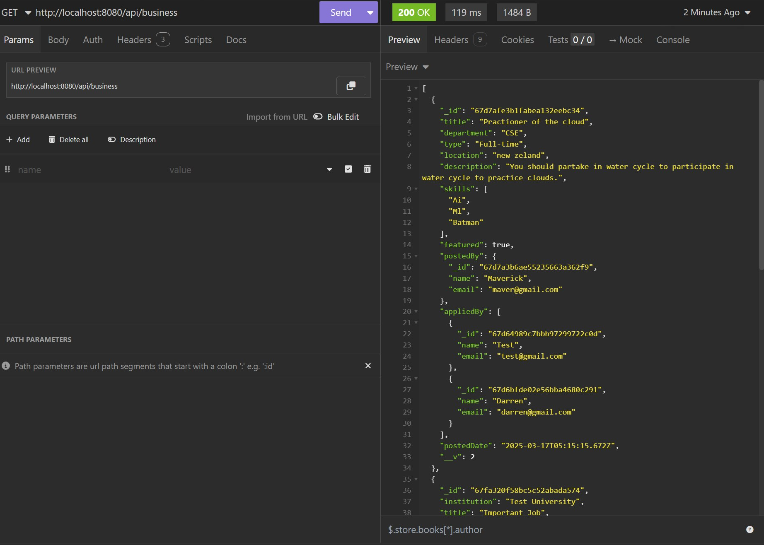

Slide 10
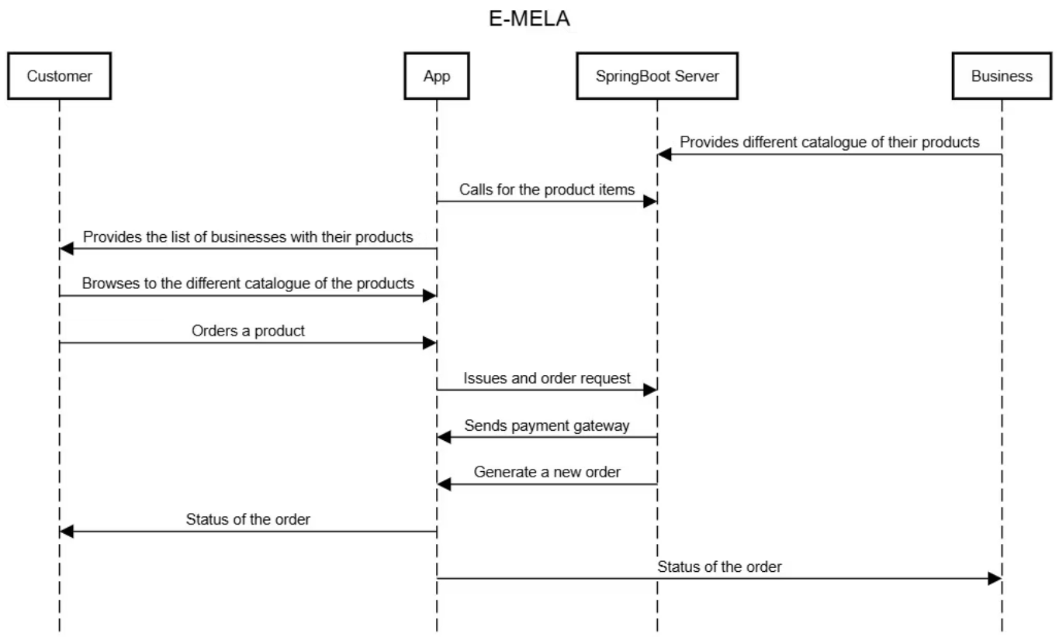

Slide 11
Conclusion
E-MELA brings the spirit of traditional melas into the digital world by empowering small and independent businesses with a commission-free, localized platform. It enhances visibility, enables instant payments, and fosters community engagement through curated storefronts and storytelling. By supporting local talent and culture, E-MELA builds a more inclusive and sustainable digital marketplace.

